Slide 1

Provider of advanced digital video, Internet, telephone and home security services

Slide 2
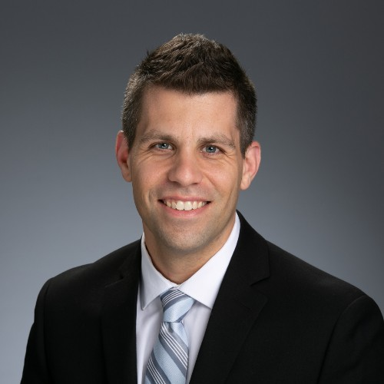


Drew Milley
Sr. Director, Analytics
Sarah Schroeter
Sr. Manager, Analytics
Brad Demerich
Manager, Analytics

Slide 3
ACOE
The Analytical Center of Excellence is a collective of data scientists, engineers, & analytical professionals that extract meaningful insights from data, that support Cox in developing strategic solutions to reduce cost and improve processes.

Slide 4
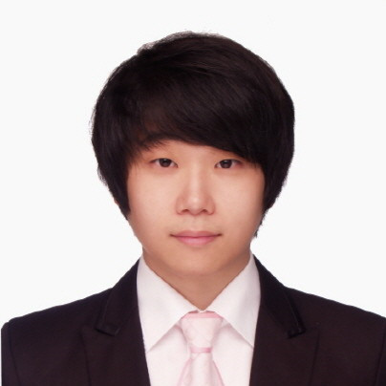
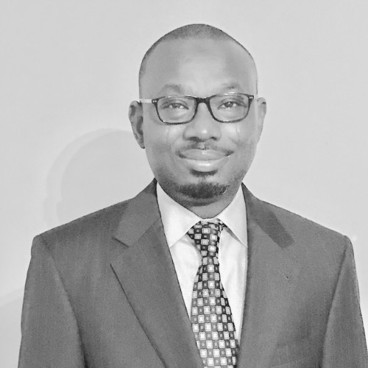
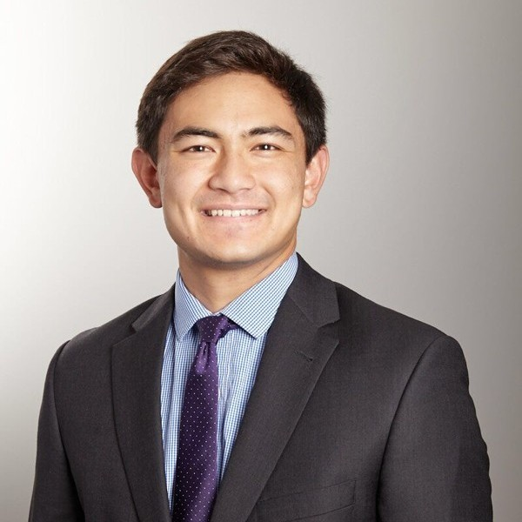
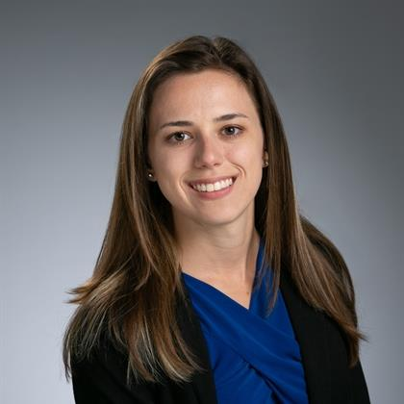
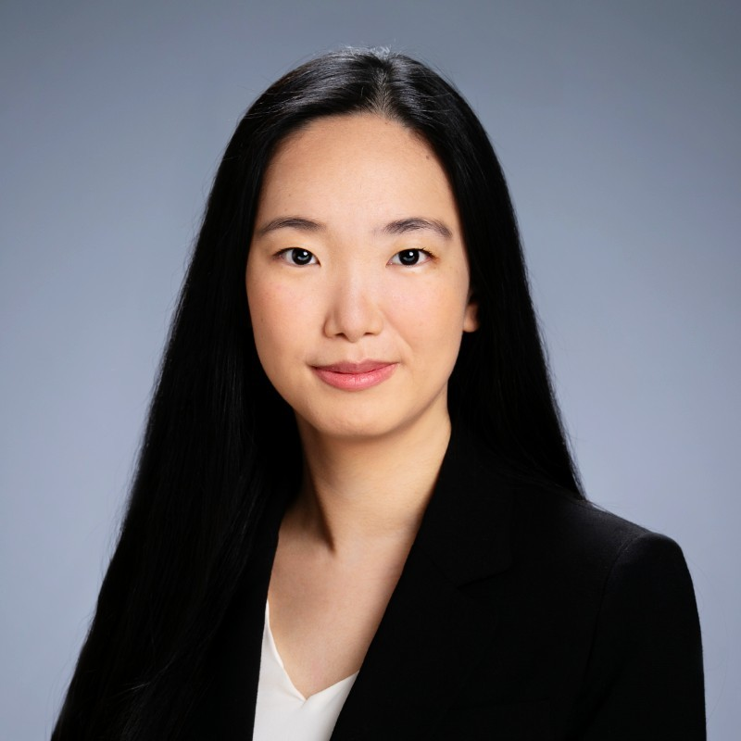
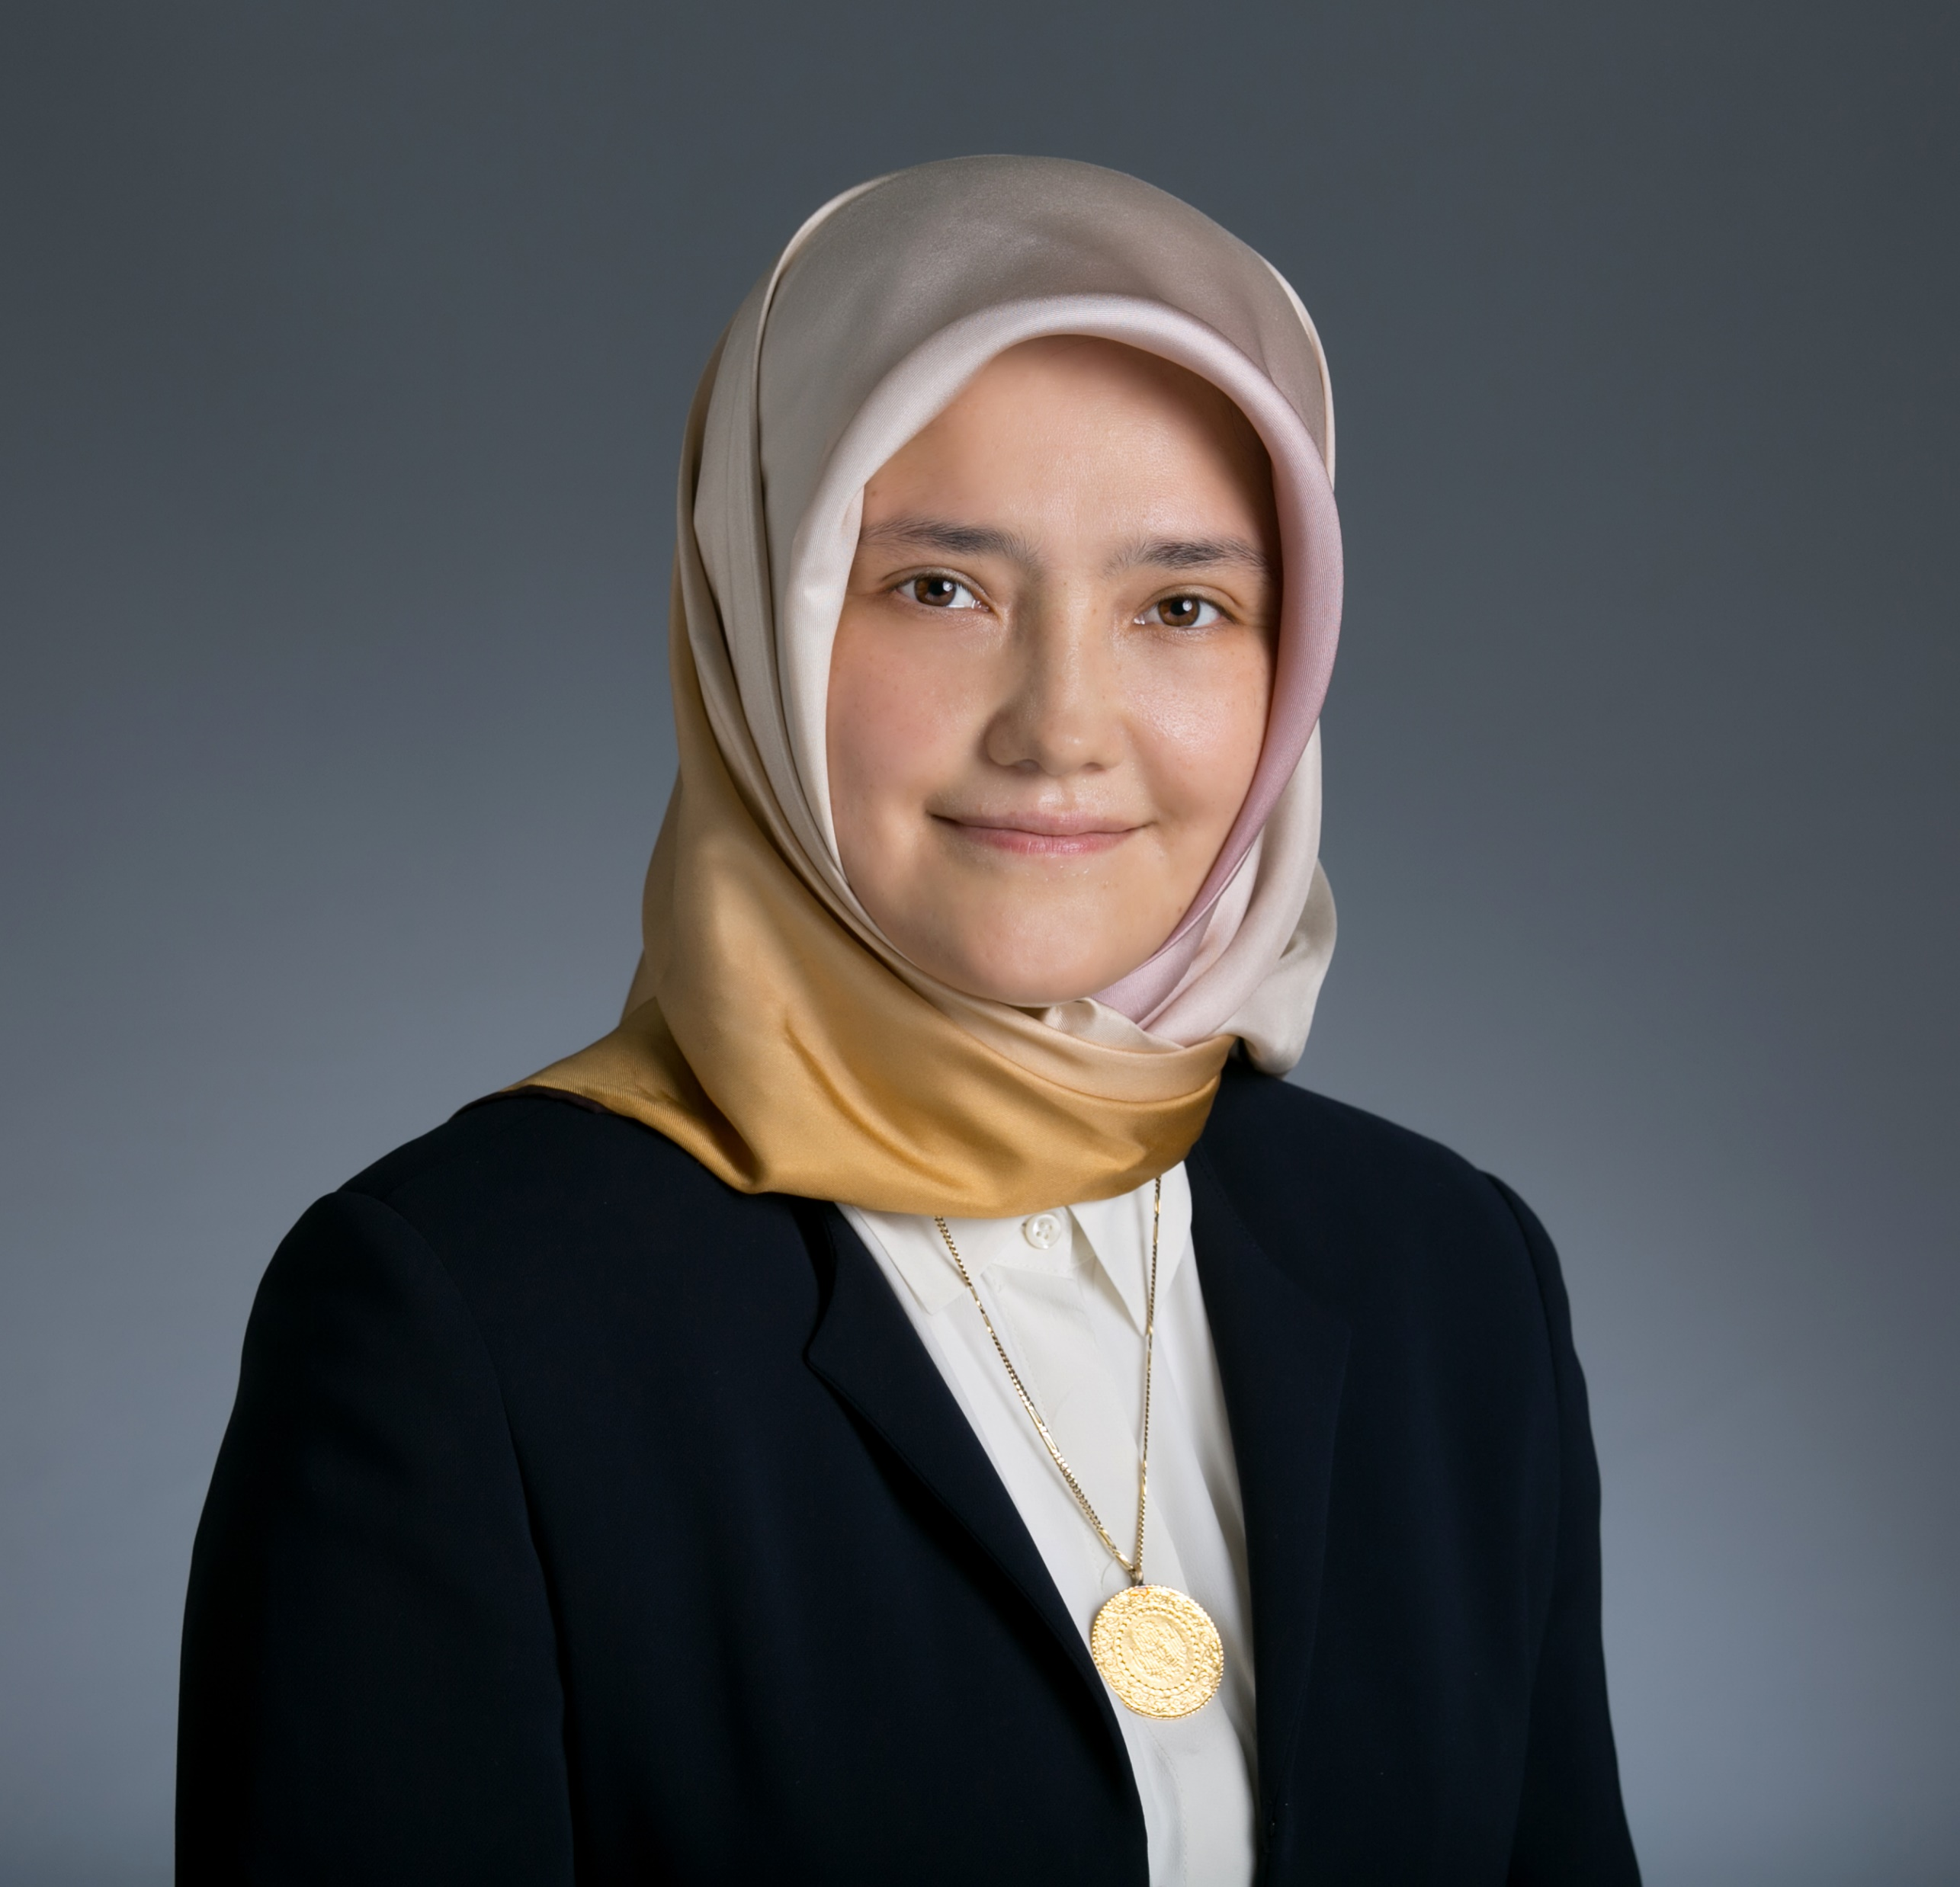
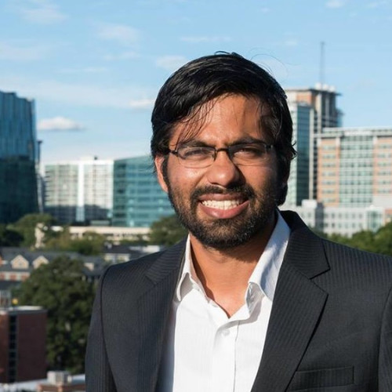
GT ALUM

Slide 5
GT ALUM
ALEXIS HWANG
2019
Graduated from Georgia Tech
Joined COX Communications
2020
Promoted to Senior Data Engineer
2021
Promoted to Data Science Manager

Slide 6
GT ALUM
London Lamb
2014
Graduated from Georgia Tech
Worked in industrial Engineering
2018
Joined COX as an Analytics Manager
2020
Promoted to Analytics Senior Manager

Slide 7
PROJECT TIME
Brad Demerich

Slide 8
PROBLEM
COX COMMUNICATIONS IS COLLECTING FULL BAND CAPTURE DATA BUT IS NOT USING IT TO ITS GREATEST EFFECT.

Slide 9
HYPOTHESIS
We can detect the sources for general network noise by targeting the most impaired customers based on their RAW signal.

Slide 10


WHAT’S BROADCAST
Broadcast is a continuous signal sent via a medium
Blah blah blah blah blah blah blah blah blah

Slide 11

BROADCASTING
THINK OF A RADIO TOWER. BROADCASTS ARE SENT TO EVERYONE NEARBY.

Slide 12


BROADCASTING
RADIOS TUNE TO SPECIFIC CHANNEL FREQUENCIES, DOCSIS DEVICES WORK IN A SIMILAR WAY.

Slide 13

BROADCASTING
Analog signal is then converted to it’s digital counterpart.
ANALOG
DIGITAL

Slide 14
BROADCASTING
A bad signal means poor conversion
ANALOG
DIGITAL

Slide 15







THE PHYSICAL PLANT
splitter
amp
tap

Slide 16
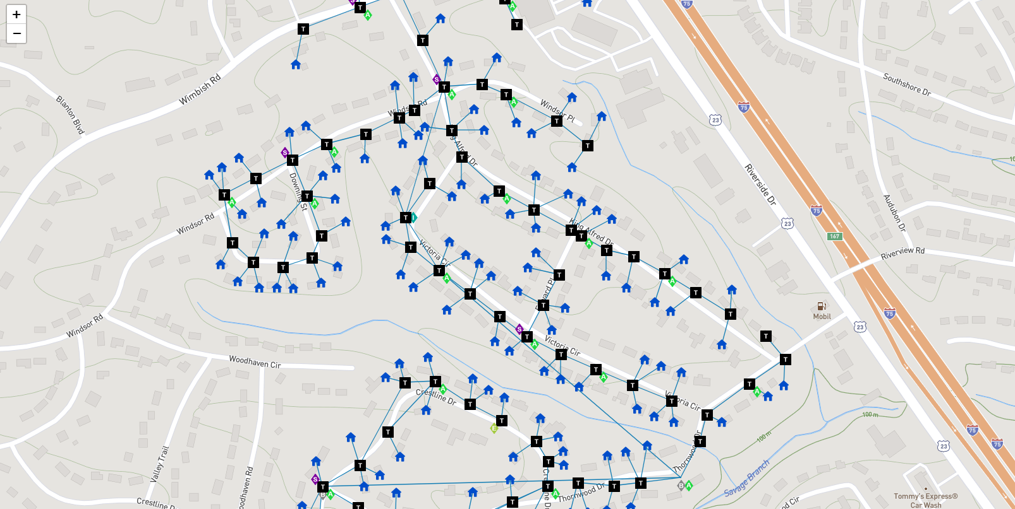
PHYSICAL NETWORK
…and map the clusters to network elements

Slide 17
WHAT’S FBC
Full Band Capture is a sweep of the entire broadcast range visible to a device.

Slide 18
WHAT’S FBC
IN OUR CLOSED NETWORK, WE HAVE BROADCASTS, BUT AT A MUCH LOWER POWER LEVEL.
DATA
DATA
DATA
FM BAND
4G BAND

Slide 19
HYPOTHESIS
WE CAN DETECT INGRESS WHERE THERE SHOULDN’T BE BROADCASTS.
INGRESS

Slide 20
OTHER IMPAIRMENTS
WE’RE CATEGORIZING IMPAIRMENTS
NOTCH

Slide 21
HOW DATA IS APPLIED
We find devices with like signatures…

Slide 22
HOW DATA IS APPLIED
…and map the clusters to network elements

Slide 23

THE DATA SETS
fbc.7z
device_id: The device’s distinct network ID.
amplitude: array like string containing the full band capture energy. Data stored as actual_dB*100.
collection_time: when the FBC data was collected
span: total hz span of the sweep
bins: number of distinct samples in the fbc array
first: starting hz of the array
last: ending hz of the array

Slide 24

THE DATA SETS
device_geo_data.csv
mac: unique device id.
geo_id: non-unique identifier for geo location of a mac address
node: geographic region in network.

Slide 25

THE DATA SETS
network_parent_child.csv
geo_id: unique identifier for geo location of a network element.
Parent_id: unique identifier for geo location of a network element’s parent device.
lon: longitude value of geo location
lat: latitude value of geo location
device_type: type of network object

Slide 26
OBJECTIVES
Complete at least 1
1. Discover a way to cluster array like FBC strings by Node and measure precision of clustering accuracy.
2. Using secondary sources, parse the array like FBC strings for WAVE and INGRESS impairments.
3. Using the network parent to child relationships, discover a way to algorithmically find the most common ancestor of any collection of address network elements and visualize this.
4. Find a way to losslessly compress the FBC raw signal for easier access in Hive Hadoop.

Slide 27
HARD MODE OBJECTIVE
Find devices with WAVE and INGRESS, cluster those devices by array like FBC strings. Then find those devices’ most common ancestor and report the network elements that are causing the impairment.

Slide 28
JUDGING CRITERIA
ITEM | POSSIBLE POINTS
1st Task | 40
2nd Task | 20
3rd Task | 20
Presentation Quality | 20
Proofing | 20
Uniqueness of Idea | 20
Total Possible | 140
Score is out of
100 points

Slide 29
PRIZES
1st Place: $600 Per Team Member
2nd Place: $400 Per Team Member
Honorable Mention: $250 Per Team Member

Slide 30
KEY TERMS
Node: The identifier for a section of our network. Think of it like a neighborhood.
FBC: Full Band Capture. The broadcast energy that is sent through copper cable lines and is reported by a network device.
MAC: The unique serial number that represents unique internet connected devices.

Slide 31
KNOWLEDGE BASE
Cable Specification and troubleshooting
What’s a docsis network?
What’s Full Band Capture?
Digital wProcessing in Python

Slide 32
MSA PROJECT WEEK NEXT STEPS

Slide 33
VIRTUAL OFFICE HOURS
Hosted by Cox mentors via MS Teams
Drop-in basis
Opportunity to ask technical questions & to gain coaching on your final presentation PPT and delivery
Tuesday, January 11th from 11:00AM – 12:00PM
Thursday, January 13th from 11:00AM–12:00PM

Slide 34
DELIVERABLES
Deliverables must be submitted to this OneDrive folder by 12 midnight on Thursday, Jan 13th:
PPT deck for 10-minute presentation
(team presentations will be followed by 5 minutes of Q&A from judges)
Relevant code files and data output

Slide 35
PRESENTATION SCHEDULE
9:00AM– Welcome & Intros
9:10AM – Team EVAA
9:25AM – 3Mᴺ
9:40AM – Abnormal Distribution
9:55AM – All Stars
10:10AM – Break
10:25AM – Bhediyon Ka Jhund
10:40AM – Counterfactuals
10:55AM – Enigma
11:10AM – Break
11:25AM – In Data We Trust
11:40AM – Infinity Norm
11:55PM – IP Man
12:10PM – Lunch Break
1:00PM – Poissoneers
1:15PM – SLAZ
1:30PM – Team Excellence
1:45PM – Break
2:00PM – Team Luna
2:15PM – The Optimizers
2:30PM – The Outliers
2:45PM – Break
3:00PM – Bad Day to be a Dataset
3:15PM – Mean Squares
4:15PM – Announcement of Winners & Closing Remarks

Slide 36
COX IS HIRING
CAREER PAGE

